Slide 1
Moneyness
Why ETH isn’t Money
(Hint: Nothing is.)
Sunny Aggarwal

Slide 2
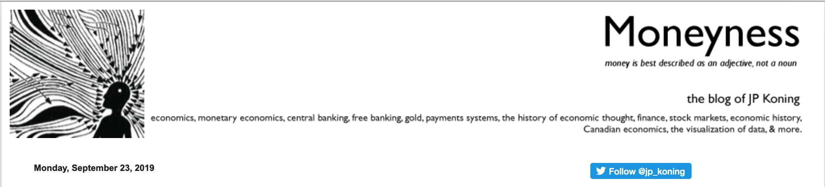


Slide 3
What is Money?

Slide 4

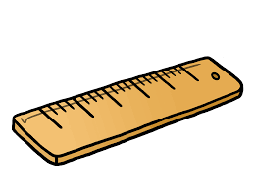

Store of Value
Unit of Account
Medium of
Exchange

Slide 5
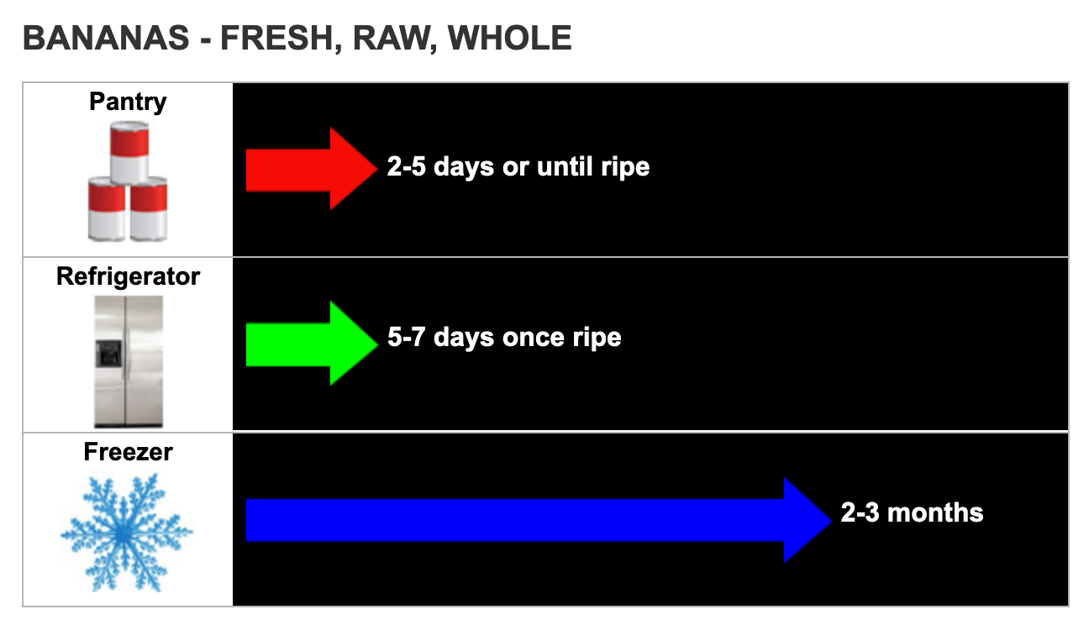

Slide 6


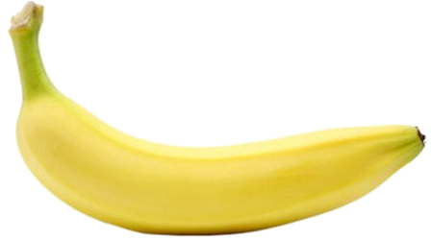

Slide 7
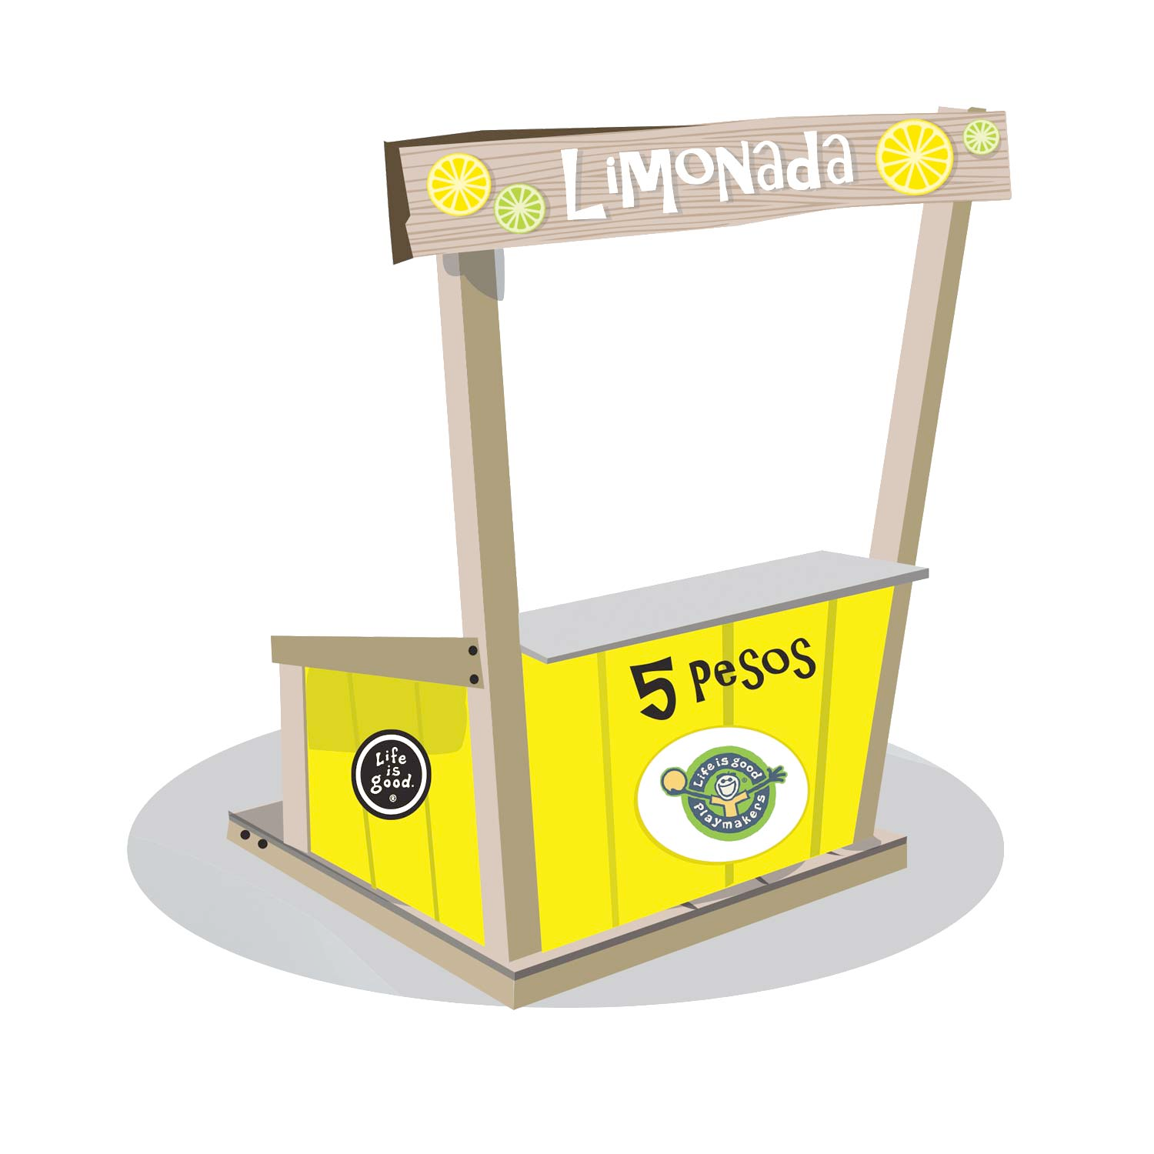

Slide 8
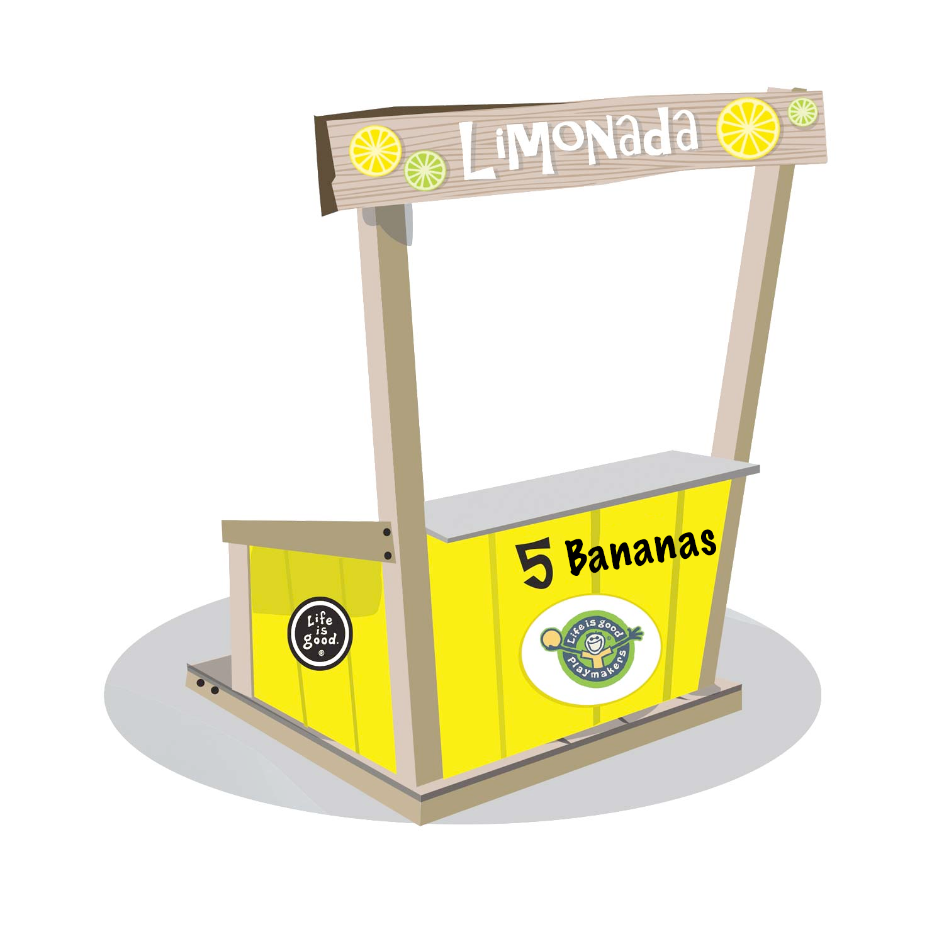

Slide 9
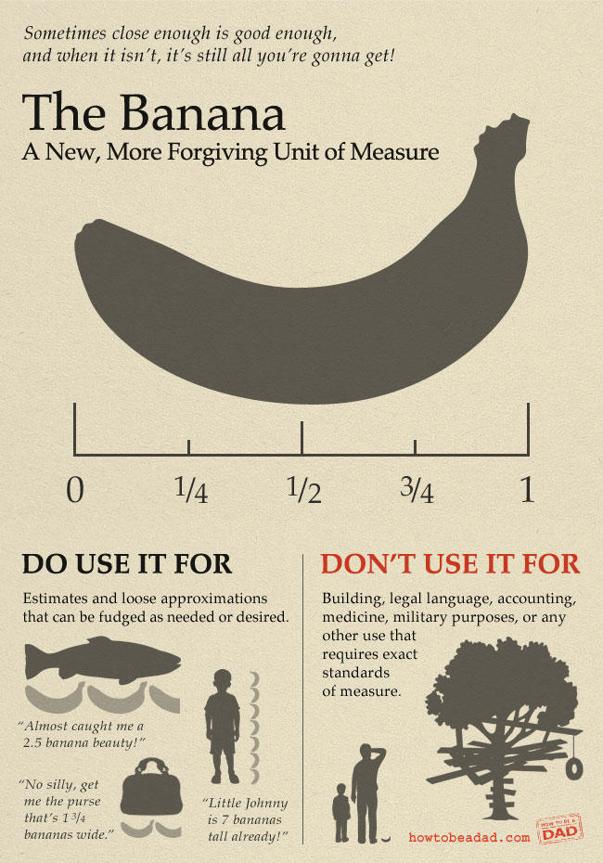

Slide 10
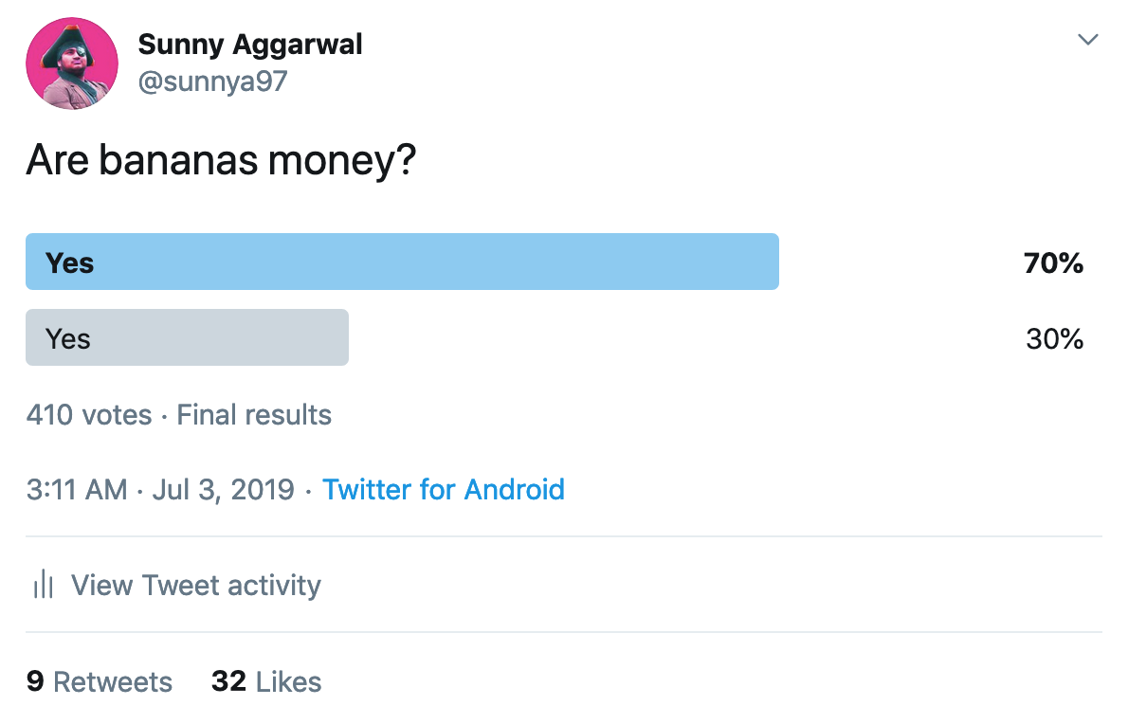

Slide 11
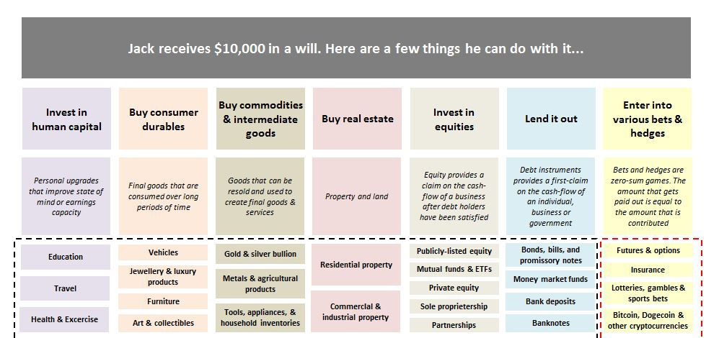

Slide 12
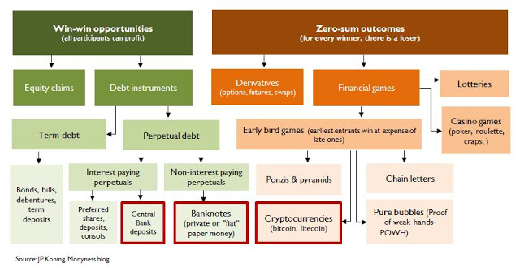

Slide 13

Moneyness

Slide 14
Store of Value
Unit of Account
Medium of
Exchange

Slide 15
Unit of Account
Medium of
Exchange

Slide 16


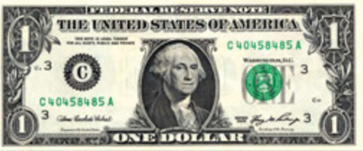

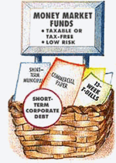
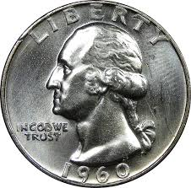
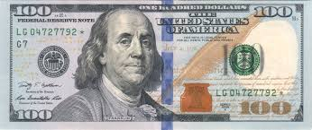
Unit of Account
Assets

Slide 17
Unit of Account
Medium of
Exchange

Slide 18
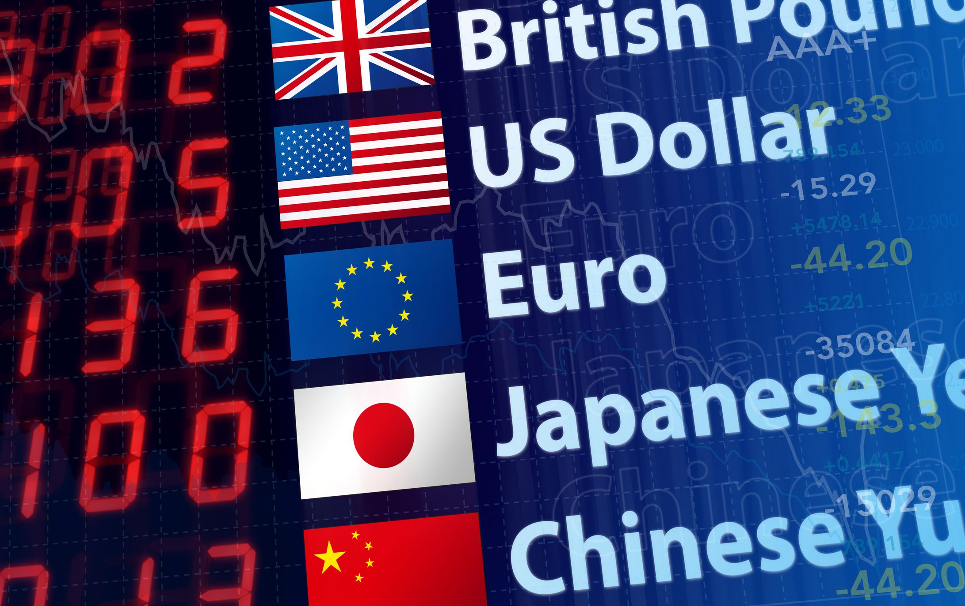

Slide 19
Prices of Money
Par
Interest
Exchange Rate
Price Level

Slide 20
Prices of Money
Par — Different types of money
Interest — Future money
Exchange Rate — Foreign Money
Price Level — Commodities

Slide 21
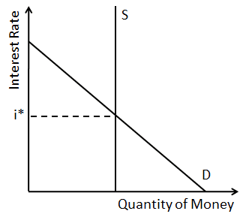

Slide 22
Medium of
Exchange

Slide 23
“A more money-like instrument is relatively more tradeable, or marketable, than a less money-like instrument.”
- JP Koning

Slide 24
Moneyness

Slide 25
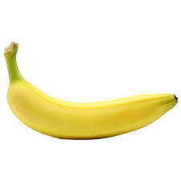
Moneyness

Slide 26
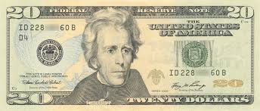
Moneyness

Slide 27
Moneyness

Slide 28

Moneyness

Slide 29
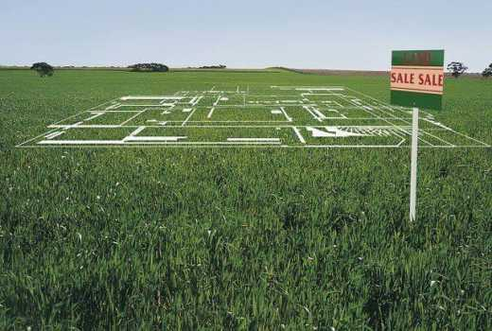
Moneyness

Slide 30
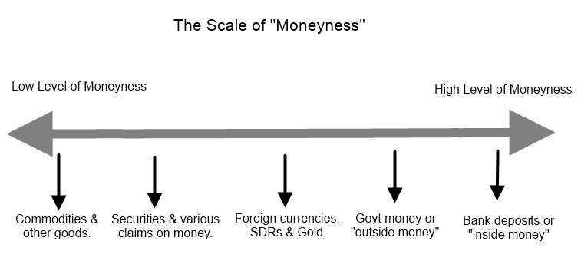
Moneyness

Slide 32
Example Useful Properties
Stability
Ease of transfer
Liquidity
Durability
Usefulness
Fungibility
Divisibility
Privacy

Slide 33

Moneyness

Slide 34
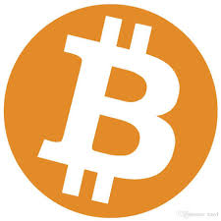
Moneyness

Slide 35
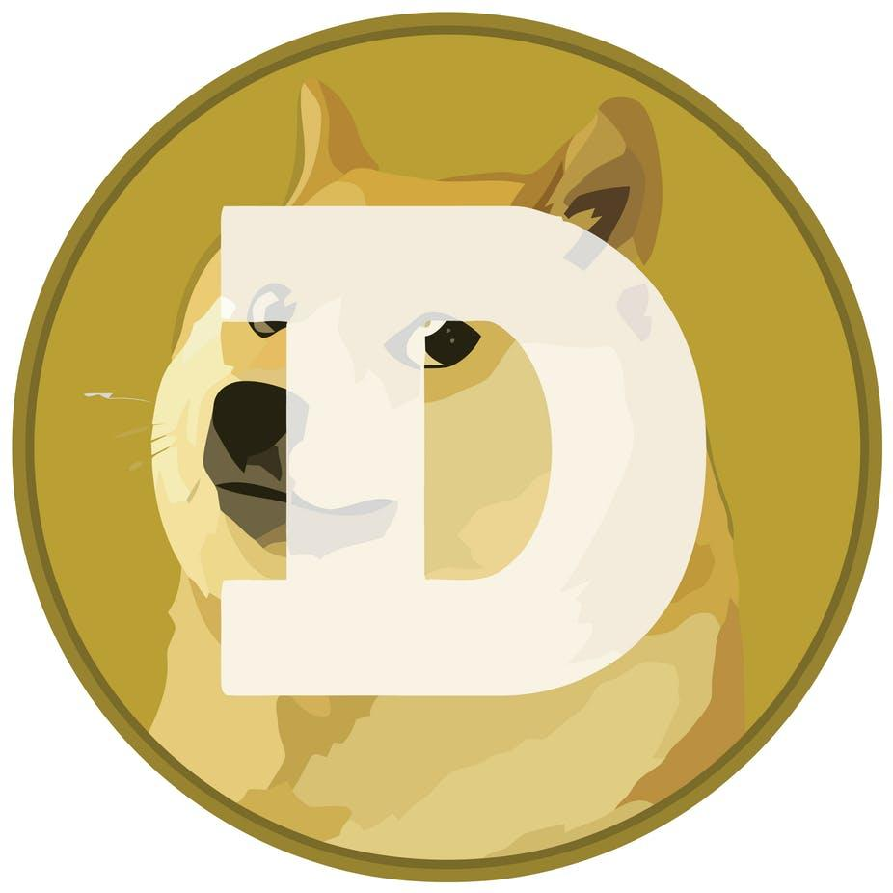
Moneyness

Slide 36
Example Useful Properties
Stability
Ease of transfer
Liquidity
Durability
Usefulness
Fungibility
Divisibility
Privacy

Slide 37
Example Useful Properties
Stability
Ease of transfer ✓
Liquidity ✓
Durability ✓
Usefulness ✓
Fungibility ✓
Divisibility ✓
Privacy

Slide 38
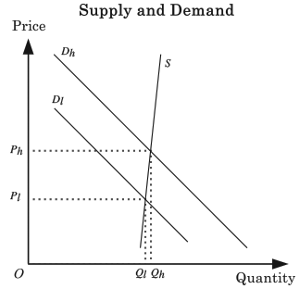

Slide 39
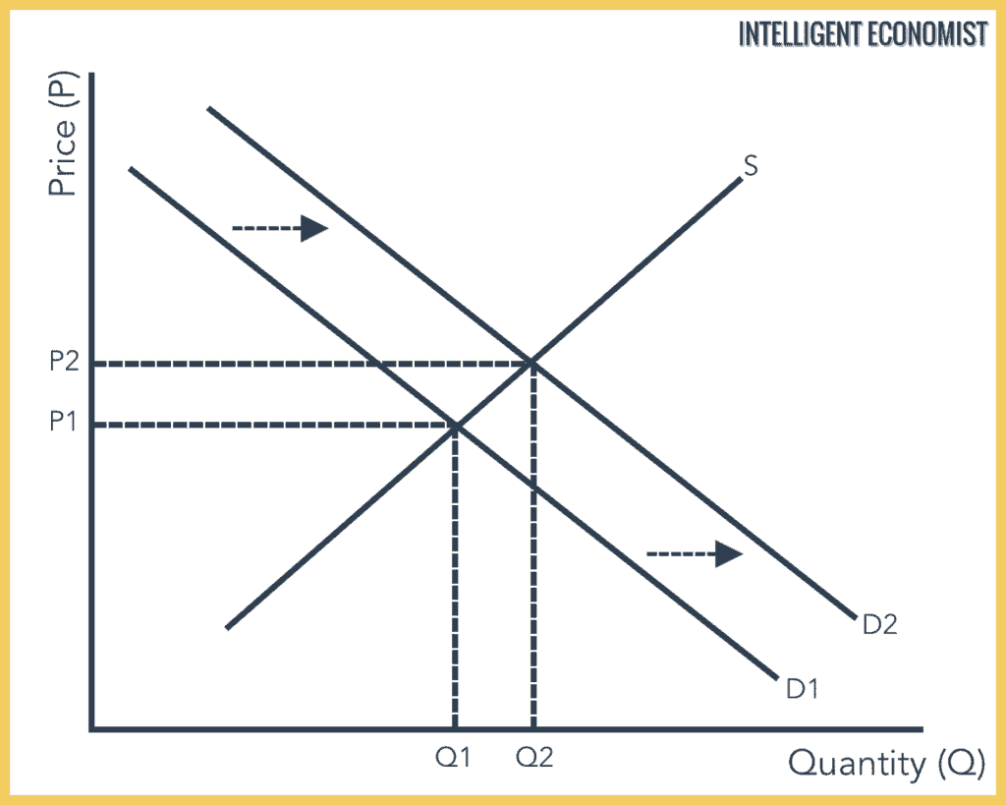

Slide 40
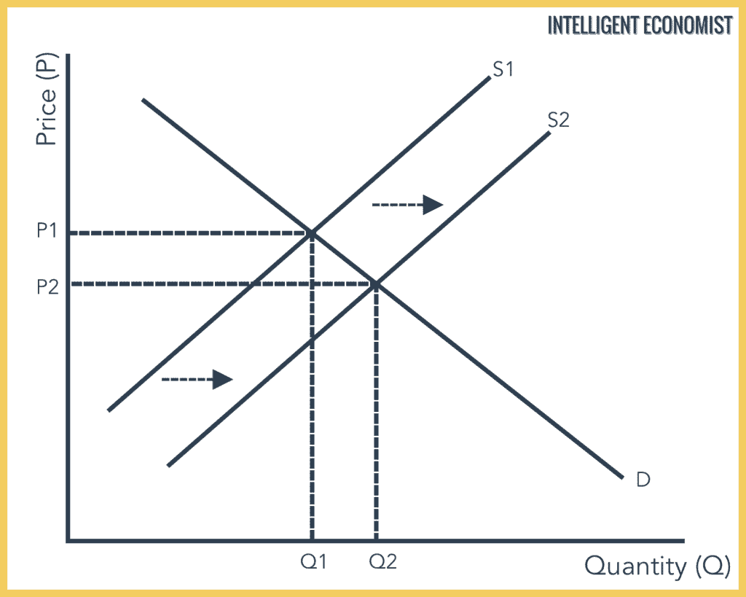

Slide 41
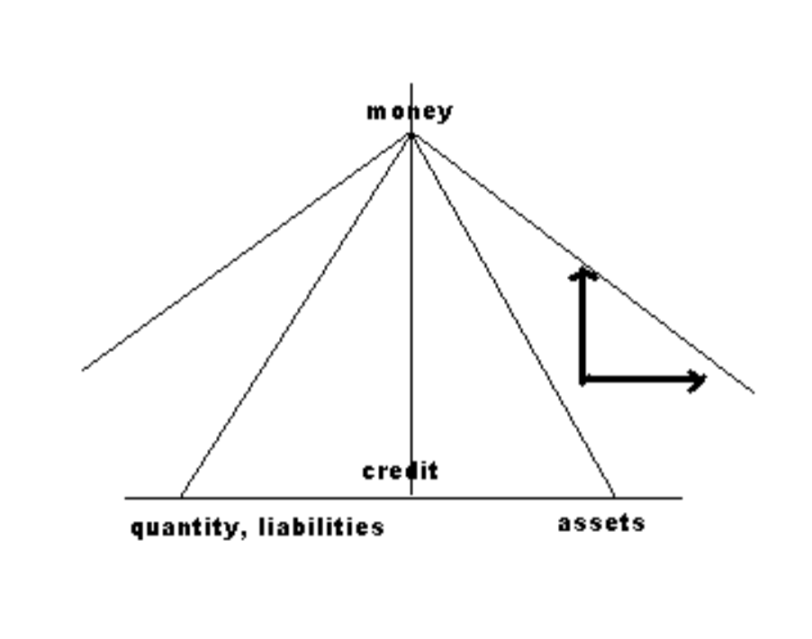
Elasticity
Discipline

Slide 42
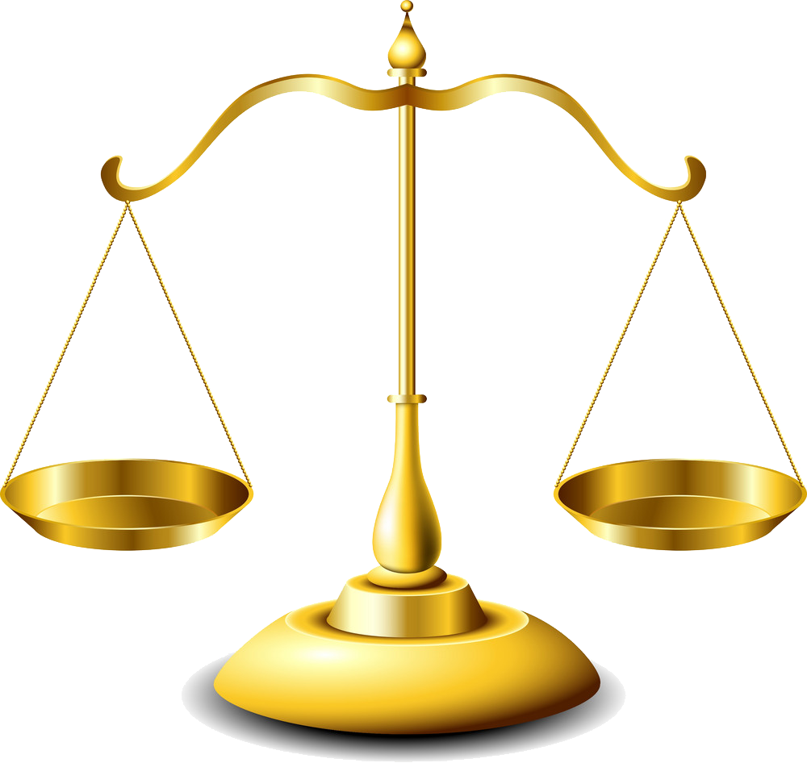
Discipline
Elasticity

Slide 43
Example Useful Properties
Stability
Ease of transfer
Liquidity
Durability
Usefulness
Fungibility
Divisibility
Privacy

Slide 44

ILP

Slide 45
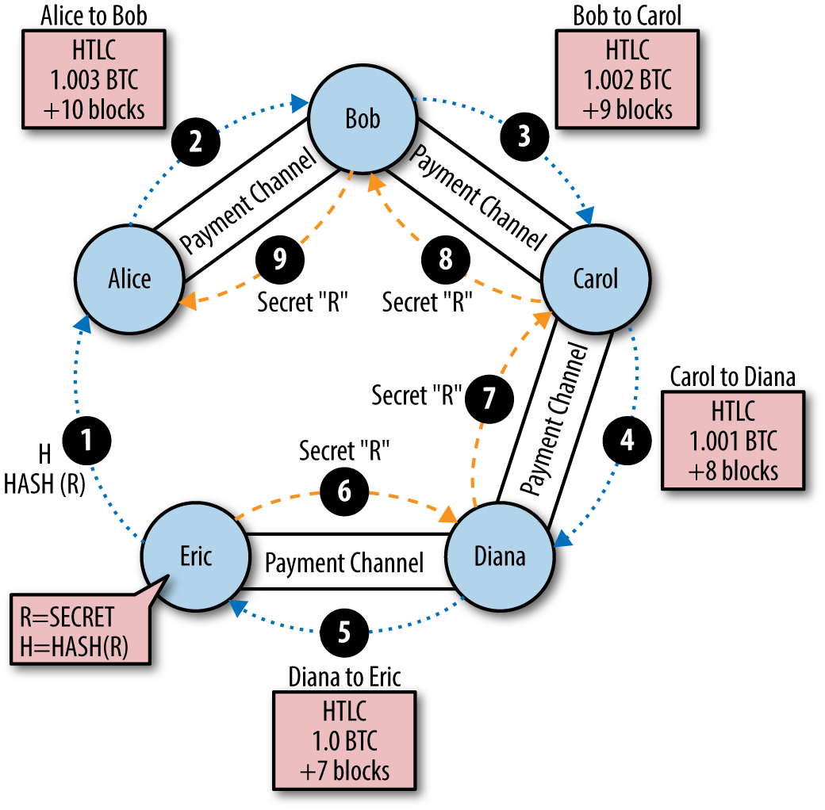


Slide 46

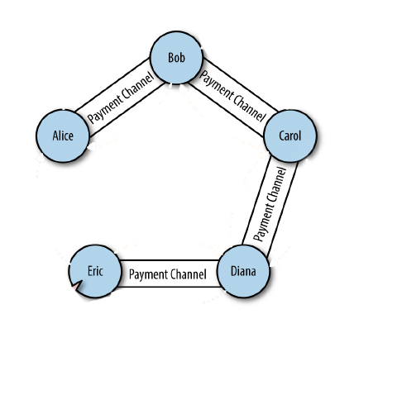
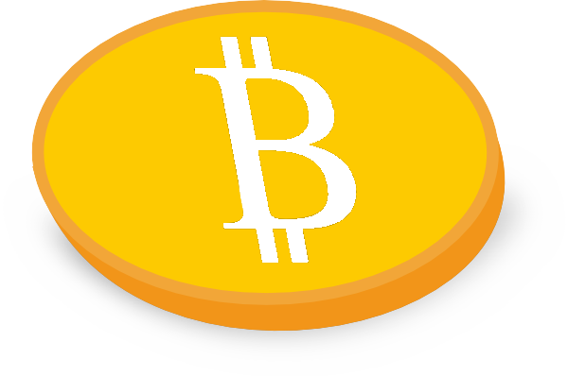

Slide 48
Ack

Slide 50
Ack

Slide 51
Ack

Slide 53
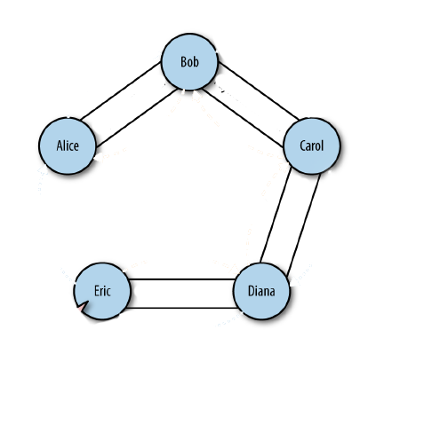
Lightning Channel
Venmo
Cosmos Chain
Connext Channel

Slide 54
Store of Value
Unit of Account
Medium of
Exchange

Slide 55
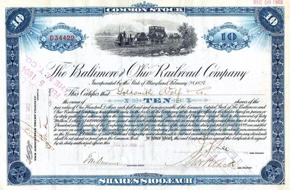
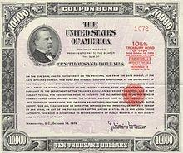
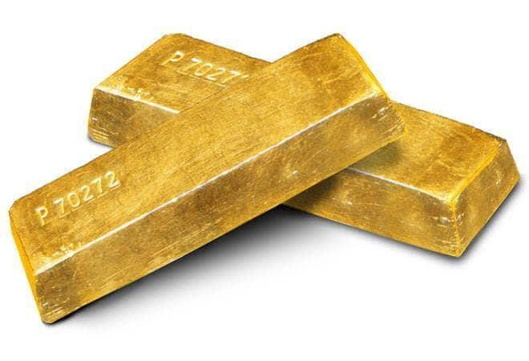
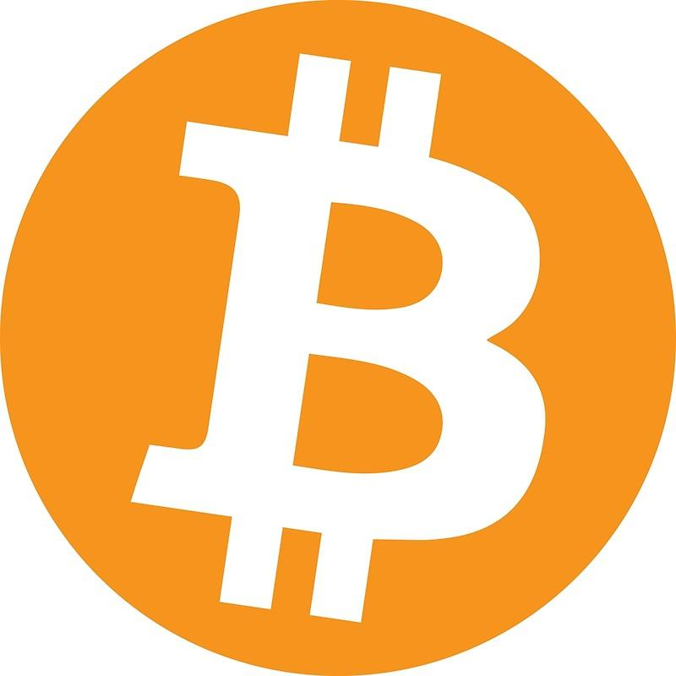
Store of Value
Unit of Account
Medium of
Exchange

Slide 56

Store of Value
Unit of Account
Medium of
Exchange

Slide 57


Slide 58

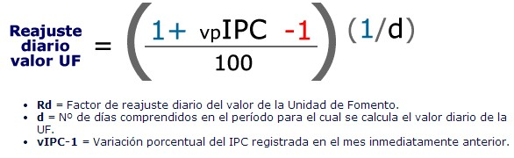

Slide 59
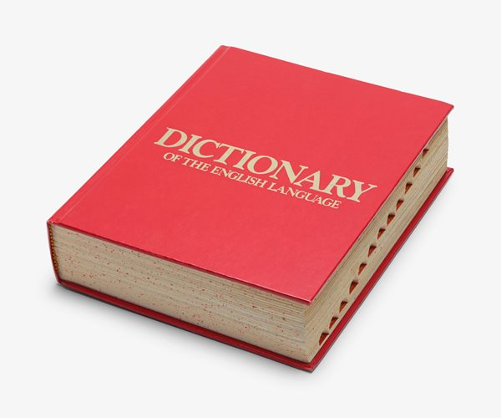
Store of Value
Unit of Account
Medium of
Exchange

Slide 60
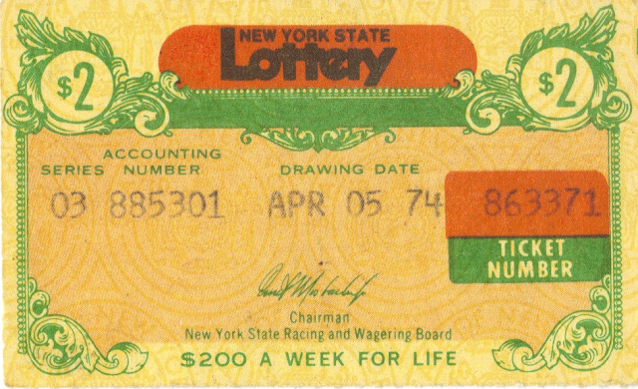

Slide 61
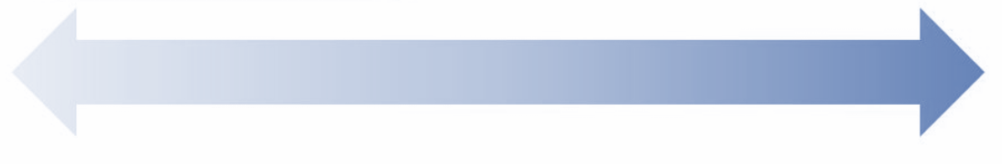

Slide 64
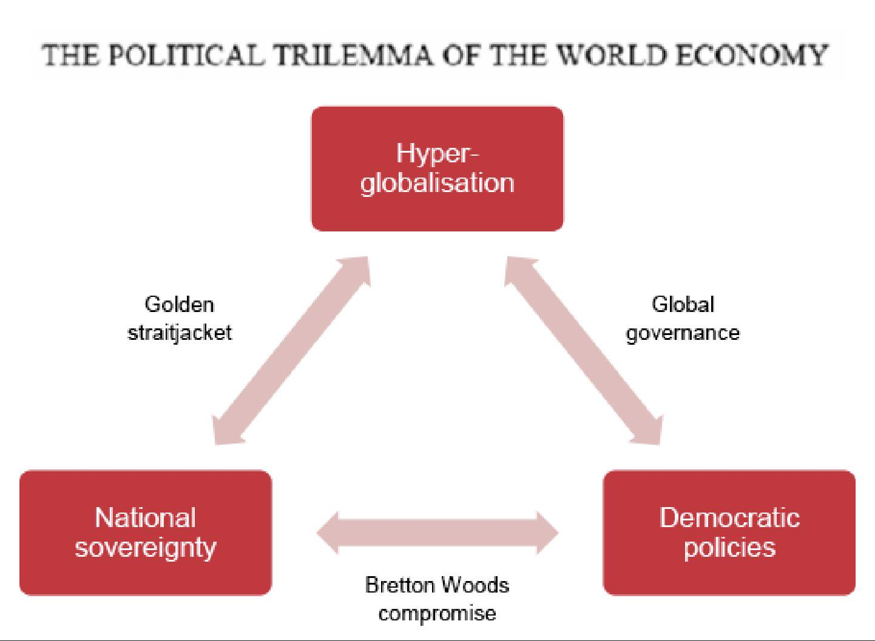
Rodrik’s
Trilemma

Slide 65
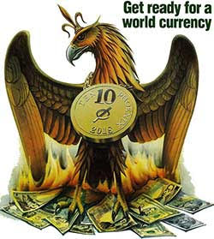
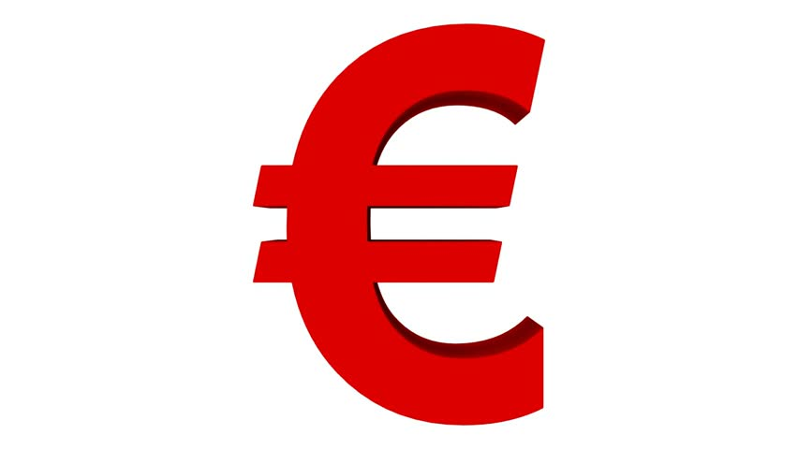
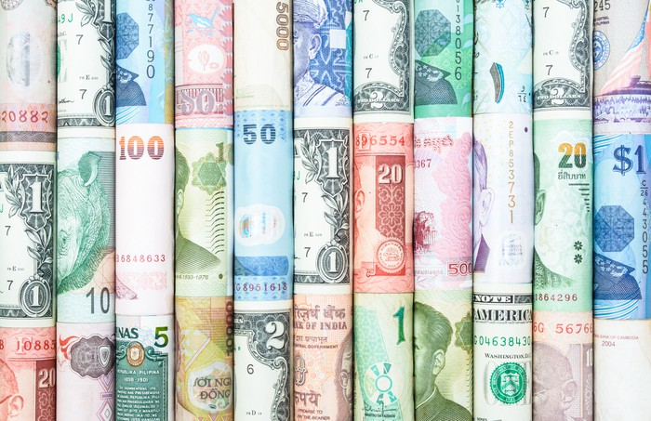

Slide 67
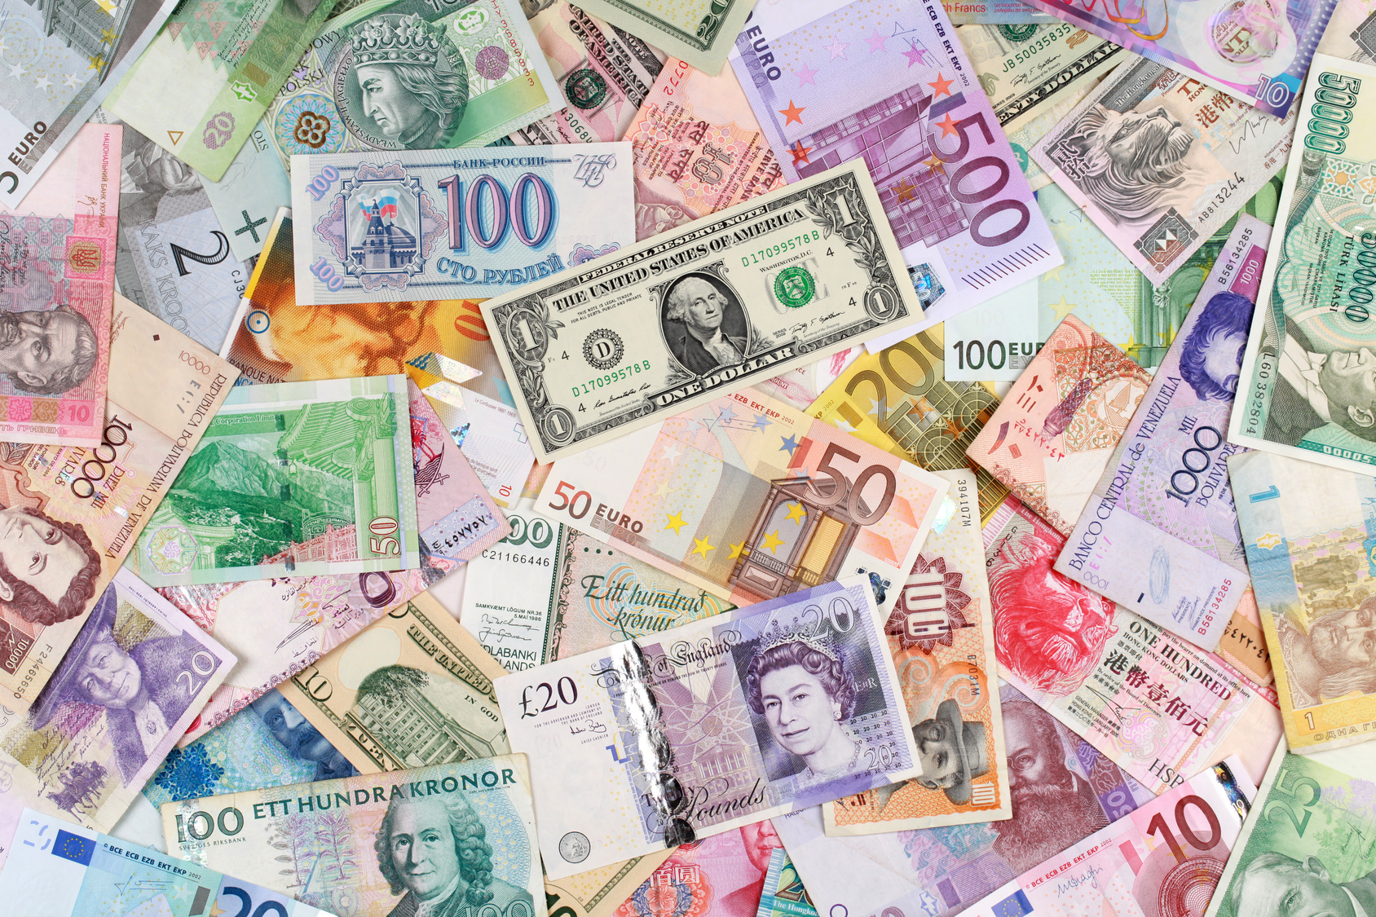

Thank You!

